Slide 1
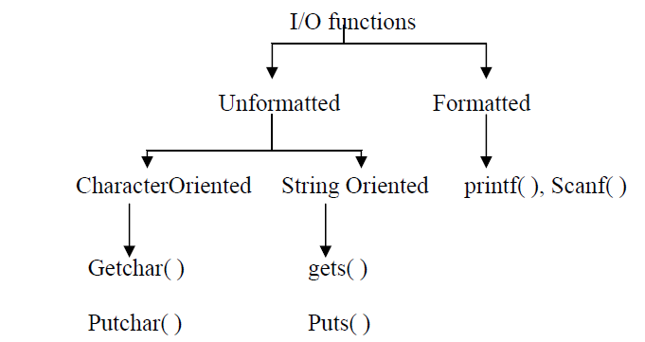
INPUT AND OUTPUT FUNCTIONS
The input functions are used to read data from input devices like keyboard, mouse, etc.
The output functions are used to display data on the monitor, printer and file storage.

Slide 2
CHARACTER ORIENTED FUNTIONS:
GetChar( )
Reads one character and returns the ASCII value of the key pressed.
The return value may be stored in a variable of type int or char.
Its syntax is: Variable = getchar( ) ;
The getchar( ) function, after reading a character, waits for the user to press the enter key.
Example: Char C1;
C1= getchar( );

Slide 3
PutChar( )
Putchar( ) prints one character on the screen.
The syntax is Void Putchar(ascii_value);
Where ascii_value is a constant or variable of type int or char.
Example: 1) Char C1;
C1= getchar( );
Putchar( C1);
Displays a character entered by the user.
2) Putchar(70);
Displays the character ‘F’
3) Putchar( “\n” );
Displays a new line

Slide 4
FORMATTED INPUT FUNCTIONS
Scanf( )
Scanf( ) stands for Scan Formatted.
Scanf( ) is used to read values in a specified format.
The general syntax is :
int scanf(“Control-String”, argument_list);
The function scanf returns the number of arguments read.
Control-string represents the field format in which the data is to be entered.
Argument_list represents the address of the location where the data is stored.
Commas separate the arguments in the argument list.

Slide 5
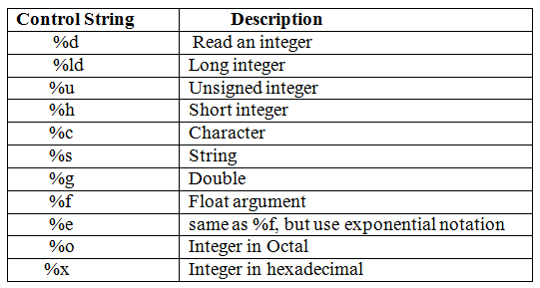
Control string contains the conversion character %, a data type character and an optional number specifying the field width.
The data type character indicates the type of data assigned to the variable.

Slide 6
Control string for integer numbers:
%wd
Where, w is an optional width of a number
d indicates the integer mode.
Example:
Scanf(“%5d %3d”, &n1,&n2);
This reads values of two integers and assigns them to n1 and n2.
If the input is 10000 and 10, then n1=10000 and n2=10
If the input is 10 and 10000, then n1=10 and n2=100
The input data must be separated by blank space, tab or newline character.
The scanf statement terminates,When the number of characters specified by the field width is reached. (or)
When a character invalid for the data value is read.

Slide 7
Reading real numbers:
The control string specification for reading real numbers is %wf
Where w is an optional field width and f indicates real mode.
Example: Scanf(“%f %f”, &f1,&f2);
Scanf(“%7f”, &f1);
If input is 12.3456, then f1=12.3456

Slide 8
Printf( )
It specifies print formatted and is used to display a message.
The syntax is Printf(“Control-string”, argument-list);
Control string consists of ,
Messages to be printed on the screen.
Format specifiers to define the format for the values to be displayed.
Escape sequence characters like \n, \t etc.

Slide 9
Example:
Printf(“Welcome to the world of C \n”);
Output:
Welcome to the world of C
Printf(“ i is %d\n”, i);
Output:
The string %d is replaced with the value of the variable i is (value of i)

Slide 10
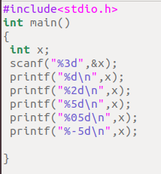
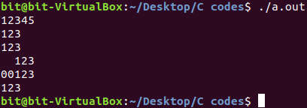
Output of Integer numbers
Syntax:
%wd, where w specifies the minimum field width.

Slide 11
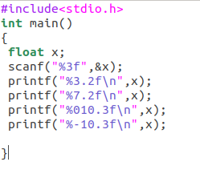
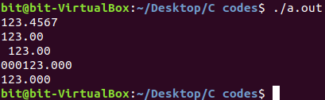
Output of real numbers
Syntax:
%w.p f, where w indicates the minimum number of positions that are used for display and p indicates the number of digits to be displayed after the decimal points.

Slide 12
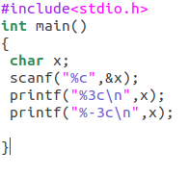

Printing a single character
Syntax:
%wc, where w is field width.

Slide 13
READING AND DISPLAYING STRINGS
Gets( )
Gets a string as an input.
Example : Char string[10];
gets(string);
Gets a word from the input and stores it in a array string.
#include<stdio.h>
main()
{
Char string[20];
Printf(“Enter a string:”);
gets(string);
printf(“%s”, string);
}

Slide 14
Puts( )
Prints the string.
The syntax is Puts(string);
Example: #include<stdio.h>
main()
{
Char str[]= “This is an example”;
Puts(str);
}

